Slide 1


Migrate. Innovate. Enable
Unlock the full power of Azure
Internal Presentation
Website: www.snp.com
Contact Email: sales@snp.com

Slide 2

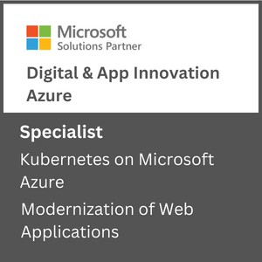
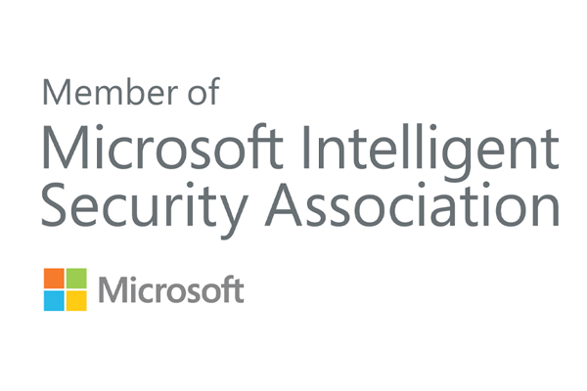
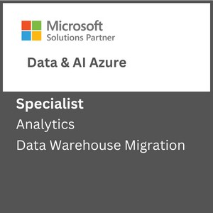
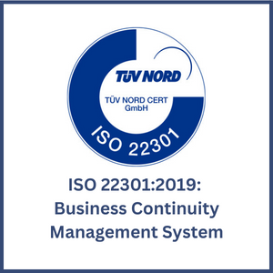
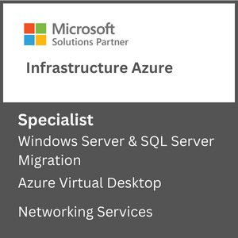
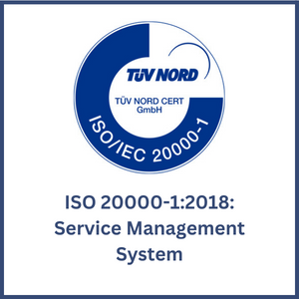

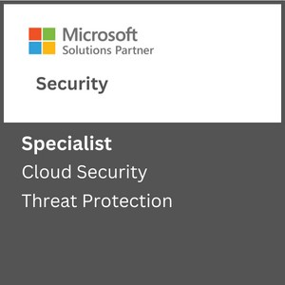
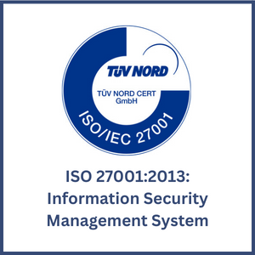

About SNP
Driving Innovation & Business Excellence with Microsoft Azure in:
SNP is Azure Innovate Ready helping transform businesses with innovative, cloud-based solutions that harness the power of Microsoft Azure. We are 100% Azure Focused. 100% SMC Focused. and 100% Certified for Different Microsoft Funding Programs like SA, PIE, ECIF, AMM and AAAP.
SECURITY
Defend Against Threats with SIEM Plus XDR
Secure Multi Cloud Environments
Secure Identities and Access
Protect and Govern Sensitive Data
Mitigate Compliance and Privacy Risks
DevSec Ops
MICROSOFT ADVANCED
SPECIALIZATIONS
APPS & INFRASTRUCTURE
Migrate and Modernize Your Infrastructure and Workloads - WS/SQL on Azure; Linux/OSS DB on Azure; AVS; AVD
Protect Your Data and Ensure Business Resiliency with BCDR- Azure Backup, Azure Site Recovery, BCDR Solutions
ANALYTICS ON MICROSOFT AZURE
NETWORKING SERVICES
AZURE VIRTUAL DESKTOPS
KUBERNETES ON MICROSOFT AZURE
Migrate enterprise apps to Microsoft azure
INFRA & DATABASE MIGRATION TO MICROSOFT AZURE
CLOUD SECURITY
THREAT PROTECTION
DATA WAREHOUSE MIGRATION
Modernize Your Workloads with Azure at any Scale with HPC plus AI- Azure specialized VMs, Azure Cycle/Batch, Storage Services, Networking Services.
Innovate Across Hybrid and Edge with Azure Arc- Azure Arc, Arc-enabled data and ML, AKS, Microsoft Defender, Azure Monitor ,Azure Stack HCI
ISO Certifications:
DevOps on Azure: DevOps Maturity Model, CI/CD, IaaC, DevSecOps
DATA, ANALYTICS & AI
Innovate with AI and Cloud Scale Databases in Every App- Azure Cognitive Services, Azure Applied AI Services, Azure Cosmos DB, Azure MySQL & PostgreSQL, Azure SQL DB, Azure ML
Migrate and Modernize Your Data Estate- Azure SQL MI, Azure SQL IaaS, Azure Arc Data, Azure Cosmos DB, Azure PostgreSQL​, Azure MySQL
MICROSOFT PARTNER AWARDS
Power Business Decisions with Cloud Scale Analytics- Azure Synapse, Azure ML, Azure Databricks & PBI
Enable Unified Data Governance- With Microsoft Purview get unified data governance across on-premises, multi-cloud, and SaaS environments
DIGITAL & APPLICATION INNOVATION
2023 PARTNER OF THE YEAR
FINALIST
Security
Modernize Enterprise Applications- Azure App Service , Azure Spring Cloud, API Management, Logic Apps, Power Apps, AKS
Innovate and Scale with Cloud Native Apps - AKS, Azure Functions, Azure Container Apps, Azure DB for PostgreSQL, Azure Cosmos DB, Azure Arc
2021 MSUS PARTNER OF THE YEAR WINNER
Business Excellence in Solution Assessments
Enable Developer Productivity and Accelerate Delivery- Power Apps, Power Automate
Accelerate Innovation with Low Code- GitHub, Visual Studio
AZURE MANAGED SERVICES
2019 MSUS PARTNER OF THE YEAR WINNER
Intelligent Cloud & OSS on Azure
CSP Hosting Services
Support Desk Operations
Managed Azure Infrastructure Operations
Managed Security Operations
Managed App Services and Kubernetes.
Optimization Services
Managed DR & Backup Operations
Managed Data Operations
Managed DevOps Services
2019 PARTNER OF THE YEAR FINALIST
Open-Source Applications & Infrastructure on Azure
LICENSE RESALE
Azure Billing & Subscription Management
CSP Management
Cloud Cost Optimization

Slide 3
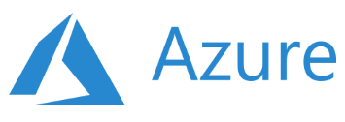
Key Focus Areas
Recent Projects
Artificial Intelligence & Machine Learning
Data Engineering Services
Database Modernization
MLOps
Solution Architecture & Consulting Services
Business Intelligence & Visualization Services
Power Bi with Synapse Analytics
Data Platform in 30 Days
Data Integration Services
Enterprise DW Modernization
Data Integration Services
ML Model Building & Consulting
ML Platform Operationalization (MLOps)
SQL Server Modernization with Azure PaaS
Power BI Governance
Power BI Development
Data, AI & Analytics
Migrate and transform data for data driven customers using solutions such as data engineering, BI and AI
Apps & Infrastructure
Hybrid Cloud
Hybrid Security Rationalization & Strategy
Cloud Infrastructure & Management
Hybrid Cloud Strategy with Azure Arc
App Innovation
DevOps & GitOps Solutions
Open-Source Solutions
Hybrid Identity
API Management
Infrastructure Rationalization & Migration Roadmap design
Servers Lift & Shift
OSS & SQL Migration to PaaS
Citrix Virtual Desktops
Windows Virtual Desktops
Hybrid Cloud Framework
Hybrid Management with Azure Arc
Compliance Policy as a Code
Hybrid Security Rationalization
.NET – Application Modernization with Azure PaaS
OSS - Application Modernization with Containers & Azure PaaS
AKS Maturity Model
Kubernetes & Containers
Red Hat Cloud Solutions
DR & Cloud Failover
Azure Sentinel & SIEM Integration
Azure Sentinel - Workflow & Connectors development
End-to-end cloud solutions which include infrastructure and operations, DevOps and automation and application modernization
Azure Managed Services
CSP Hosting Services
Support Desk Operations
Managed Azure Infrastructure Operations
Managed Disaster Recovery & Backup Operations
Virtual Desktop Infrastructure –(VDI) Operations
Managed Data Platform Operations
Managed DevOps Services
Managed Security Operations
Managed VDI Operations (Citrix & Windows VDI)
Premium Managed Services
Azure Managed Services supporting the full Microsoft Azure solution suite including infrastructure, data, security, DevOps and more
Industries We Serve
Healthcare
Biotech
Financial Services
Manufacturing
Professional Services
Engineering & Architecture

Slide 4
COMPUTE SERVICES
KONYALA DATHA SAI CHANDU​

Slide 5
AGENDA
Cloud Services
Virtual machines
Availability options
Virtual machine scale-sets
Functions
Container instances
Azure app service
Kubernetes
5
Notes:
Extras
What are compute services in azure:
Category of on-demand services used to run cloud-based applications.
Describe the benefits of high availability and scalability in the cloud
Describe the benefits of reliability and predictability in the cloud
Describe the benefits of security and governance in the cloud
Describe the benefits of manageability in the cloud

Slide 6
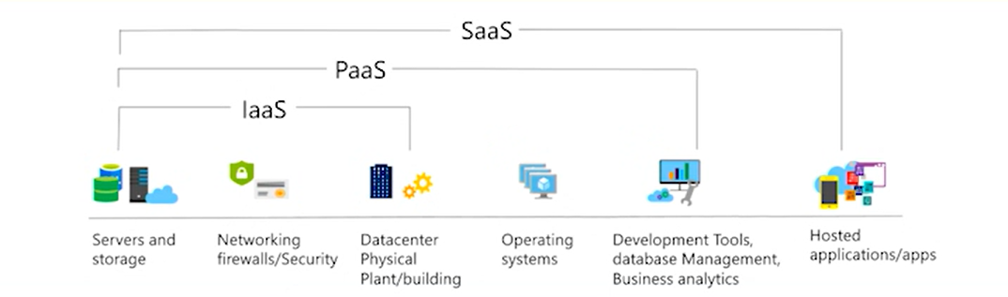
Cloud Services
IaaS - Build pay-as-you-go IT infrastructure by renting servers, virtual machines, storage, networks, and operating systems from a cloud provider.
PaaS - Provides environment for building, testing, and deploying software applications; without focusing on managing underlying infrastructure.
SaaS - Users connect to and use cloud-based apps over the internet: for example, Microsoft Office 365, email, and calendars.
6
Notes:
User Responsibilities
Operating System: Users are responsible for managing and maintaining the operating system, including applying patches, updates, and configuring security settings.
Applications: Users are responsible for installing, configuring, and managing their applications on the virtual machines (VMs) provided by the cloud provider.
Data: Users are responsible for managing and protecting their data, including backups and data security.
Networking: Users need to set up and configure networking components such as virtual networks, subnets, and firewalls.
Security: Users are responsible for securing their applications and VMs, including firewall rules, intrusion detection, and identity and access management.
Azure Responsibilities
Physical Infrastructure: Azure is responsible for the physical hardware, data centers, and the virtualization layer.
Network Infrastructure: Azure provides the network infrastructure and ensures network availability.
Storage Infrastructure: Azure manages the storage infrastructure and ensures data durability and availability.
Datacenter Security: Azure is responsible for the physical security of data centers and compliance with industry standards.

Slide 7
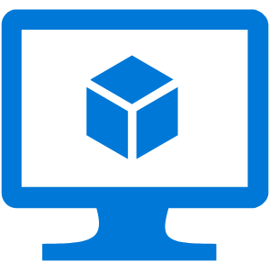
Virtual Machine
VMs provide infrastructure as a service (IaaS).
Virtualization is the process of creating a "virtual" version of a computer, with dedicated amounts of CPU, memory, and storage that are "borrowed" from a physical host computer and/or a remote server—such as a server in a cloud provider's datacenter.
The virtual machine is partitioned from the rest of the system
When you provision a VM, you’ll also have the chance to pick the resources that are associated with that VM, including: Size, Storage disks, Networking.
Nodes using Availability Sets — 99.95% SLA
Nodes using Availability Zones — 99.99% SLA
7
Notes:
Deploying VM in ava sets and ava zones
Scaling in VM’s
Different types of Vm’s
Types of Disks storage (HDD, SSD)
Combination of CPU, ram, networking, and storage
emulation

Slide 8
Availability Options
Availability zone
physically and logically separated datacenters with their own independent power source, network, and storage
VM Scale Set
The number of VM instances can automatically increase or decrease in response to demand
Availability Set
Update Domain
An update domain is a logical group that ensures that not all VMs in an Availability Set are updated or rebooted at the same time during planned maintenance.
Fault Domain
Fault domains define the group of virtual machines that share a common power source and network switch.
8

Slide 9
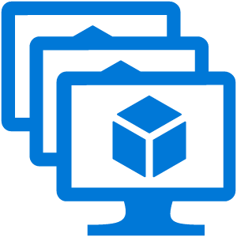
Virtual Machine Scale Set
Manage a number of Virtual Machines as one object
Can scale by using auto-scale or "dragging a slider“
Let you create and manage a group of identical, load-balanced VMs.
Scale sets allow you to centrally manage, configure, and update a large number of VMs in minutes.
Automatically increase or decrease in response to demand, or you can set it to scale based on a defined schedule.
Build large-scale services for areas such as compute, big data, and container workloads.
A scale set can have 0 to 1,000 virtual machines.
9

Slide 10
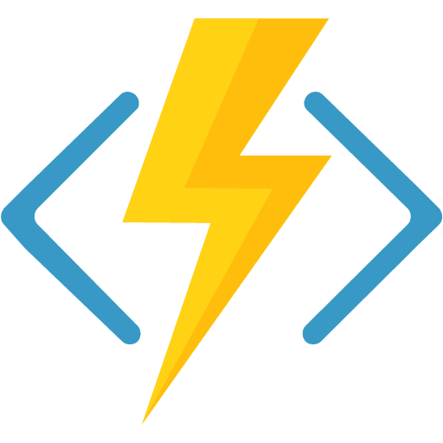
Functions
Azure Functions is a serverless compute service.
lets you run code in response to events or triggers without managing servers.
Ideal when you’re only concerned about the code running your service and not about the underlying platform or infrastructure.
Azure Functions handles the infrastructure, scaling, and execution of your code.
Functions scale automatically based on demand.
Only charged for the CPU time used while your function runs.
restarted every time they respond to an event.
Entire state of the function and entire code base of your function are saved on a storage.
10

Slide 11
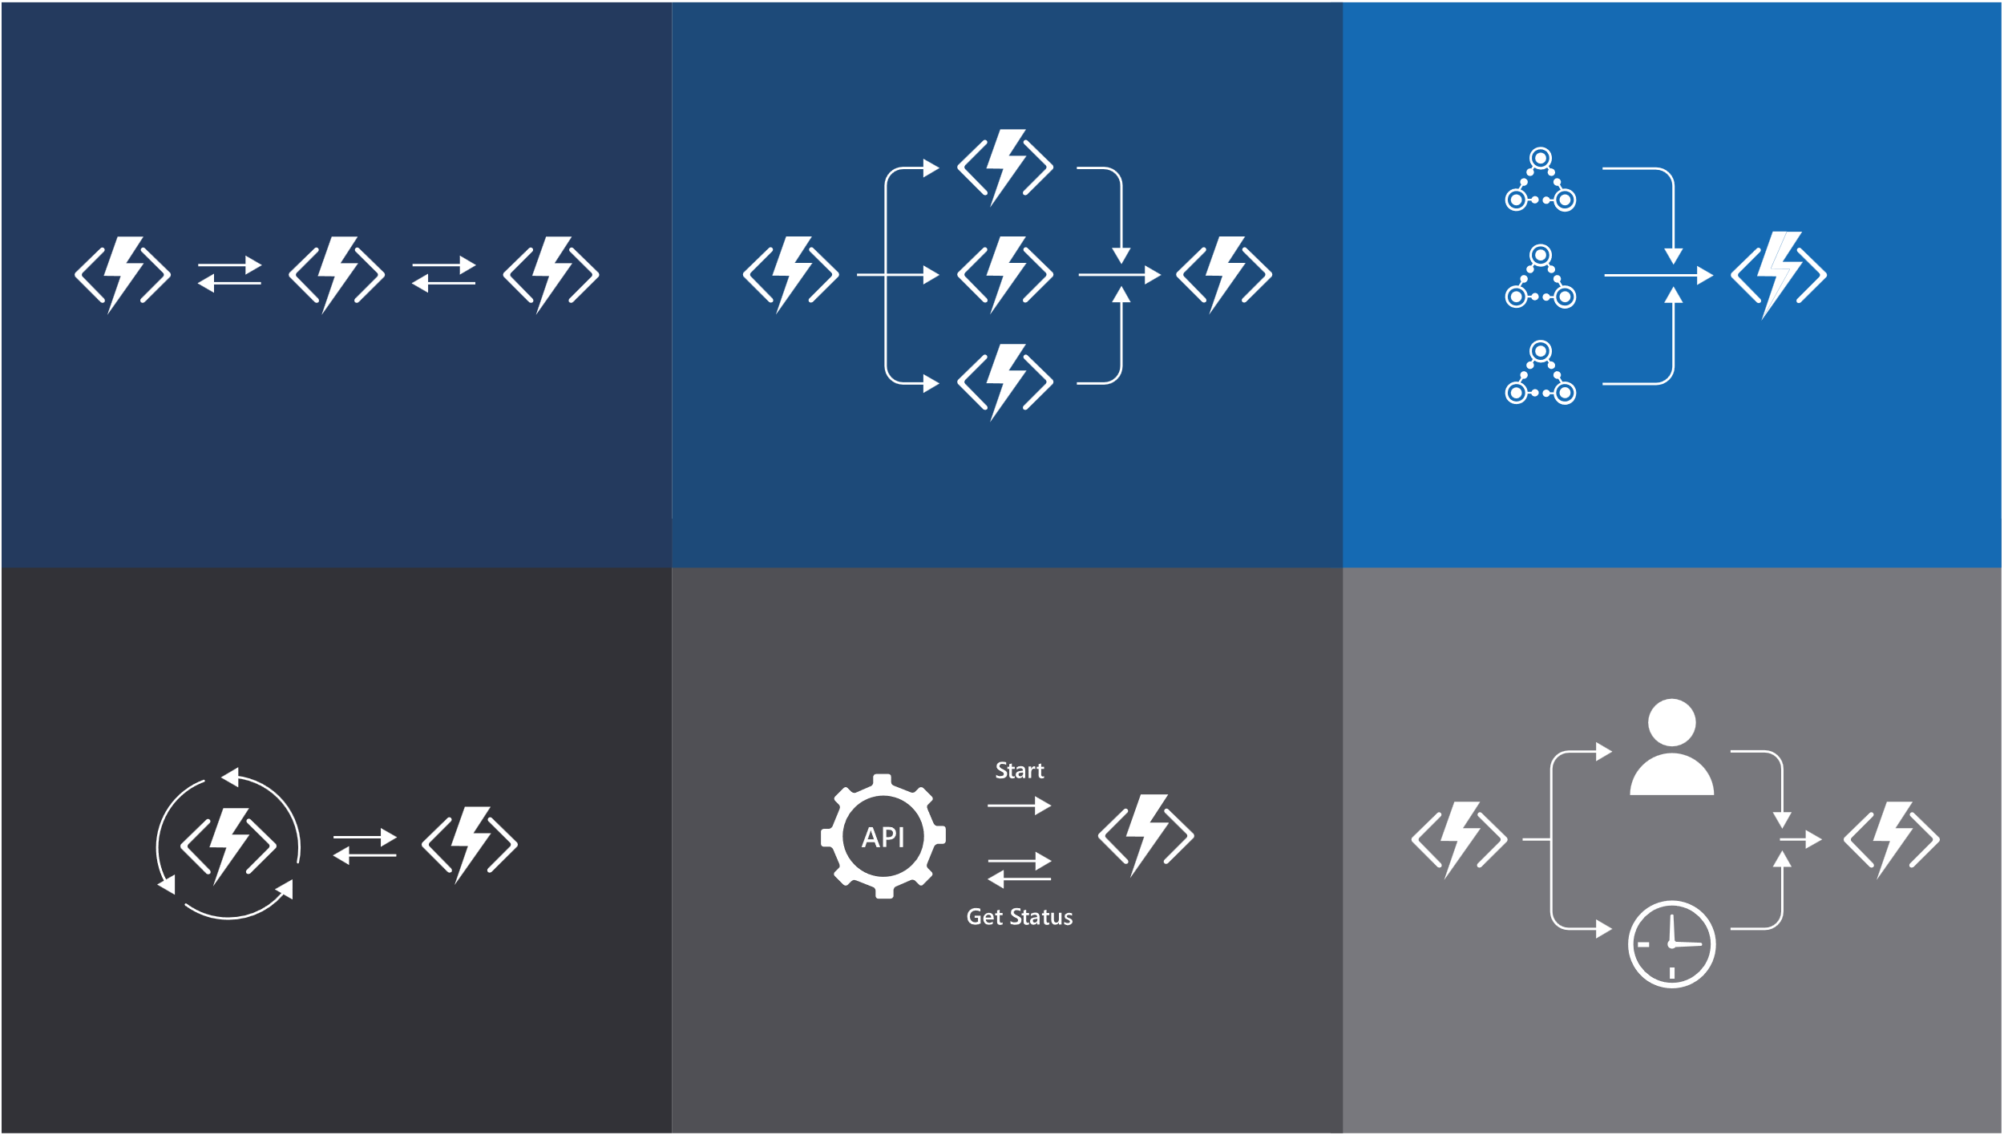
Supports multiple languages C#, java, Js, Python, F#, PowerShell, TypeScript.
In order to execute that piece of code you need something called trigger
A trigger is an action that will involve this code and will pass some basic information to this code in order to run.
And when its done, it has some sort of output.
Triggers always be one, but you can have multiple inputs and multiple outputs
Everything you’re doing functions including code is stored on storage
11

Slide 12
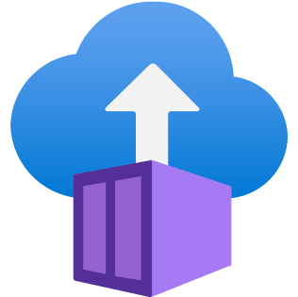
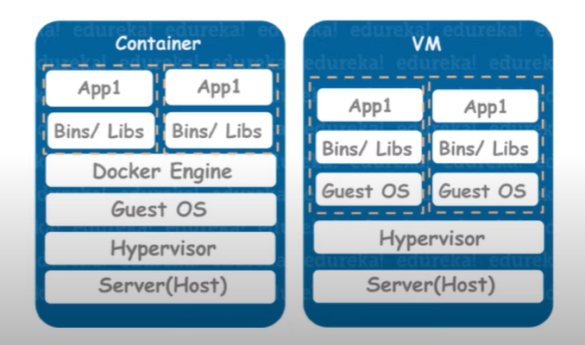
Container Instance
Azure Container Instances are a platform as a service (PaaS) offering.
You don't manage the operating system for a container. Virtual machines appear to be an instance of an operating system that you can connect to and manage.
Containers are lightweight and designed to be created, scaled out, and stopped dynamically.
You can quickly restart if there's a crash or hardware interruption.
Most popular container engines is Docker, and Azure supports Docker.
Concepts like scale, load balancing, and certificates are not provided with ACI containers.
Containers are often used to create solutions by using a microservice architecture.
12

Slide 13

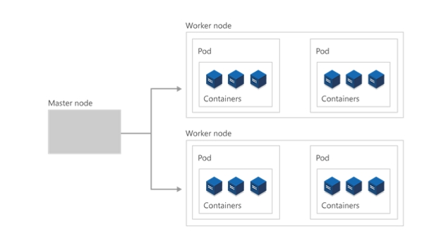
Kubernetes
Azure Kubernetes is a fully managed container management service. Container instances cannot communicate with each other that is when tools like Kubernetes comes into picture.
Kubernetes is used for container communication and this is where it is different from docker which basically used to setup containers.
You only pay for the nodes you use. AKS does not charge for your master node (Kubernetes cluster) and only charged for your worker nodes.
13
Notes:
Tell about the evolution of application infrastructure
Waterfall model (monolithic applications)
Agile (multi tire applications)
Devops (microservice applications)
No more than 110 pods per node.
No more than 5,000 nodes.
No more than 150,000 total pods.
No more than 300,000 total containers.

Slide 14

Azure App Service
Azure App Service is an HTTP-based service for hosting web applications, REST APIs, and mobile back ends. It supports multiple languages, including .NET, .NET Core, Java, Ruby, Node.js, PHP, or Python.
It offers automatic scaling and high availability.
It enables automated deployments from GitHub, or any Git repo to support a continuous deployment model.
Azure App Service is a good choice if you want to focus on developing your application and not worry about the underlying infrastructure.
If you have a small number of applications to host, then Azure App Service may be more cost-effective.
14
Notes:
Tell about app service environment
Can restrict the access from public internet by removing the public ip address
Can be used
App Service plans - Azure App
(695) Azure App Service in 15 MINUTES | Web App Tutorial - YouTube Service | Microsoft Learn

Slide 15
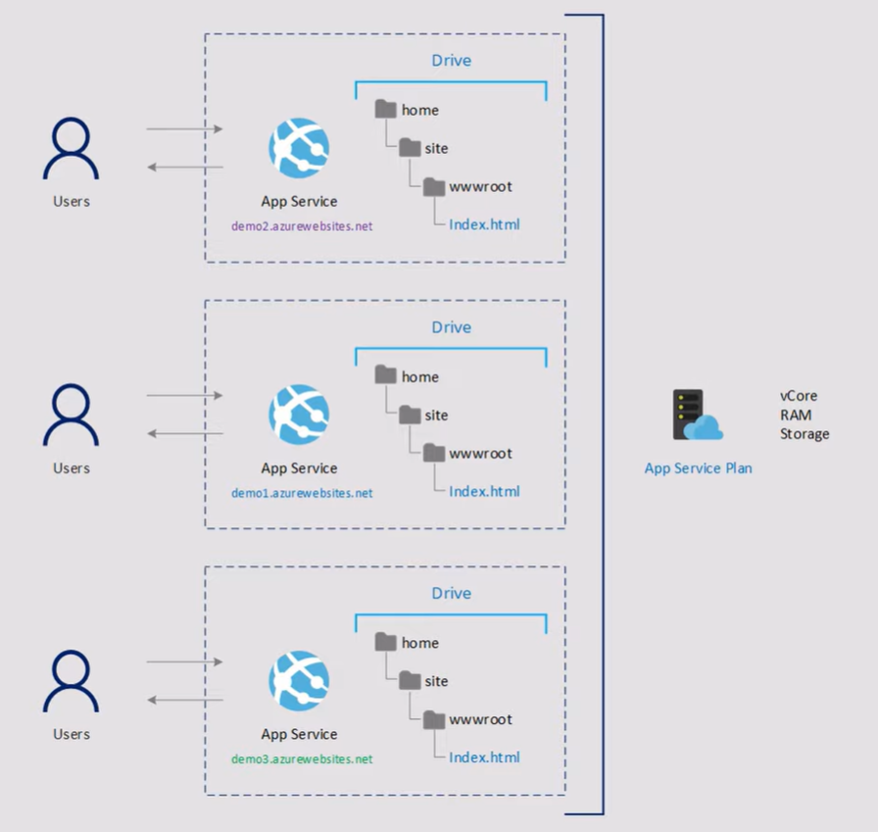
This is embedded with something called App service Plan. App service Plan is a container which has assigned capacity, like cores, RAM, Storage.
You can host multiple App services in one App service plan allowing to utilize the resources best way possible.
15

Slide 16
pricing tiers:
The higher the tier, the more features are available.
Shared compute
Free and Shared tiers share the same Azure VM, allocating CPU quotas to individual apps.
scaling out to additional VMs is not permitted.
Designed for development and testing, these tiers are cost-effective but unsuitable for production due to limited scalability.
Dedicated compute
Basic, Standard, Premium, PremiumV2, and PremiumV3 tiers use dedicated Azure VMs for running apps.
Apps in the same App Service plan share compute resources of their dedicated VMs.
Provides increased scalability for your applications.
Isolated
Isolated and IsolatedV2 tiers utilize dedicated Azure VMs on dedicated Azure Virtual Networks for running apps.
These tiers offer both network and compute isolation, enhancing the security of your apps.
Isolated tiers provide the highest scale-out capabilities, making them suitable for large-scale applications.
16

Slide 17
The App Service plan is the scale unit of the App Service apps.
If the plan is configured to run five VM instances, then all apps in the plan run on all five instances.
If the plan is configured for autoscaling, then all apps in the plan are scaled out together based on the auto-scale settings.
17

Slide 18
Thank you
Konyala datha sai chandu
dathasaichandu@snp.com
Notes:
Thank you

Slide 19

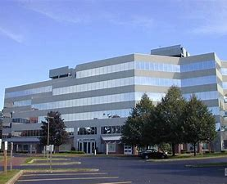

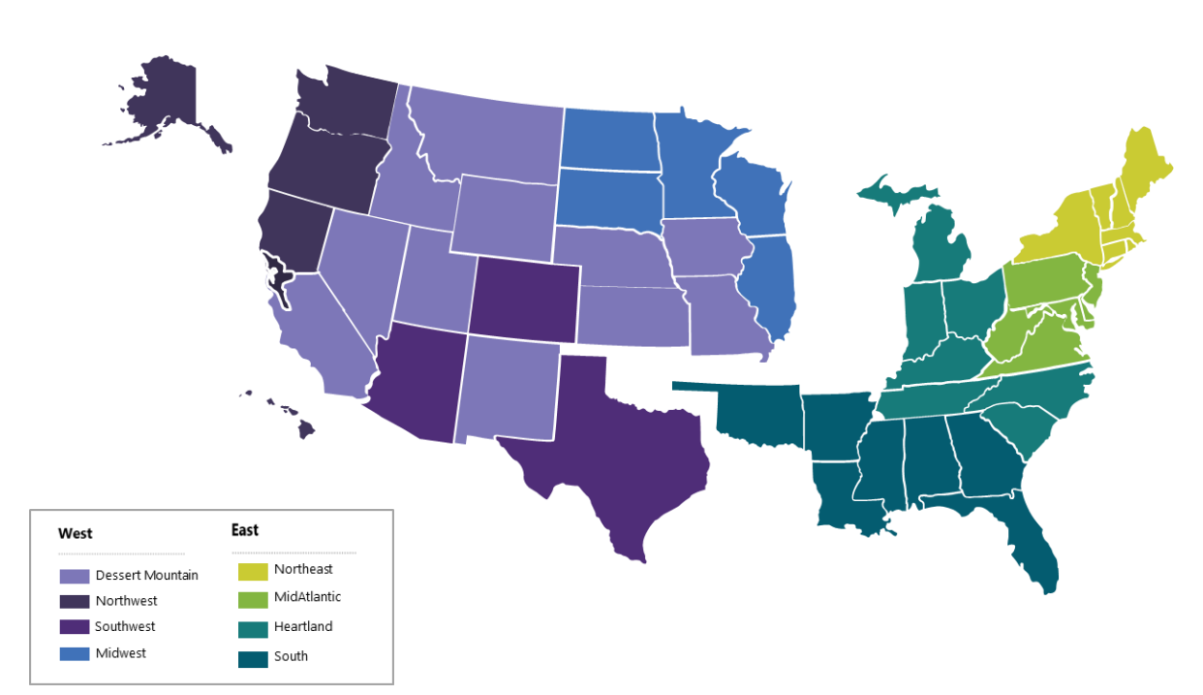

Contact Us:
Company Headquarters
SNP Technologies, 2319 Whitney Avenue, Suite 3C Hamden, CT 06518-3535,
(203) 287-9114
Sachin Parikh
VP of Business Development
sachin@snp.com
203-287-9114 X 112
Phil Balogh
Director Sales- North -USA
phil@snp.com
203-228-0310
Emerging/Investment
Market
Established
Market
Michael Fiorito
Director Sales- South- USA
Michael.fiorito@snp.com
917-753-0346
100% focused in SMC

Slide 20


www.snp.com
2319 Whitney Ave. | Suite 3C | Hamden, CT 06518

